Slide 1

eTrial Patient Cohort Identification
Team Sage Warrior

Slide 2

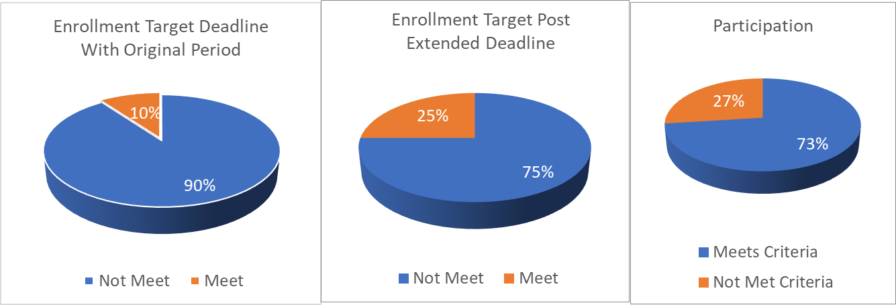
Life Cycle for Drugs to Market
Basic Science Research
Clinical Trials
Regulator Approval
1-2 Years
6-7 Years
1-2 Years

Slide 3

Major Pain Points in Clinical Trials
2.5 Hours
/ Patient
10,000 trials waiting
3 Patients / day
4,000,000 Hrs.
(Avg cost 19 million $)
** For patients having severe pains/conditions, everyday counts.

Slide 4
Solution And Technologies
Extract Inclusion and Exclusion Criteria Document in few seconds
Return Patient data based on criteria in few minutes
Lead to a streamlined cohort identification process Data
Easy to use UI - from uploading file till getting the results
Utilize NLP models like AWS Comprehend Medical and spaCy named entity recognition
Migrated data to inhouse MongoDB database for faster retrieval
All backend components are REST API services and can be easily integrated.

Slide 5






Architecture
Document Extraction Service
Amazon Comprehend Medical
Dashboard UI
Data Match API
Patient Data Storage

Slide 6
Workflow
User uploads Medical File
Inclusion and Exclusion Criteria from NLP
Display Inclusion and Exclusion Criteria on Dashboard
Call Data Match REST API
Query Patient Database
Display Filtered Patient Data

Slide 7
Q&A / Thank you
User Experience
Business Value
Speed up the patient selection process
Separate workflow for support team to train new document.
Easy to use API
Customized Deployments
Help customer to reduce the expenditure by ~40%
Drugs will be available faster to the patient. Hence reduce pains.
Huge money is spent daily to support the clinical trials by pharma companies.
Technology and Innovation
Future Plans
Following Microservice Architecture
Separate APIs for NLP and data filtering
Used Amazon Comprehend Medical for better accuracy
Used spaCy for customized NLP model.
MongoDB on premise will save cost and enhanced privacy
Functionality for Support team can train new document
Enrollment to actual clinical trial
Multi-cloud support
Report extraction for further analysis

